Slide 1
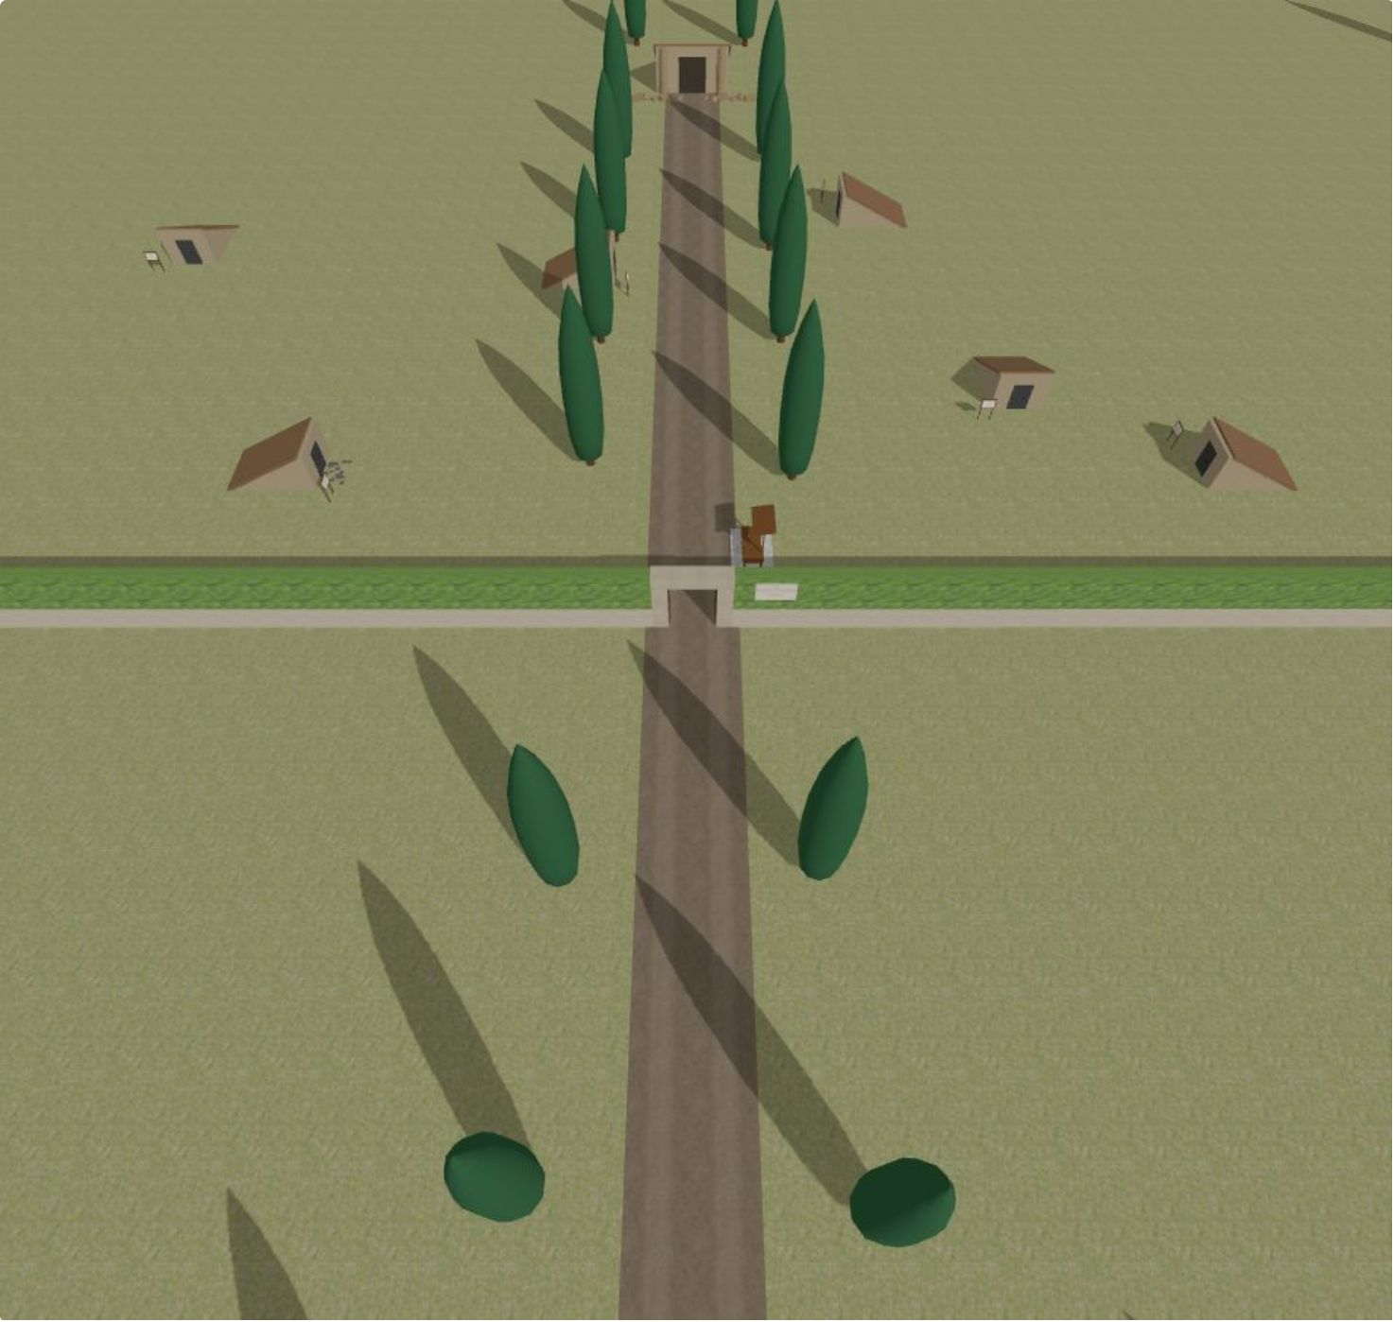
The Etruscan Tombs: Secrets of Tarquinia
Interactive Graphics Project — Sapienza University of Rome

Slide 2
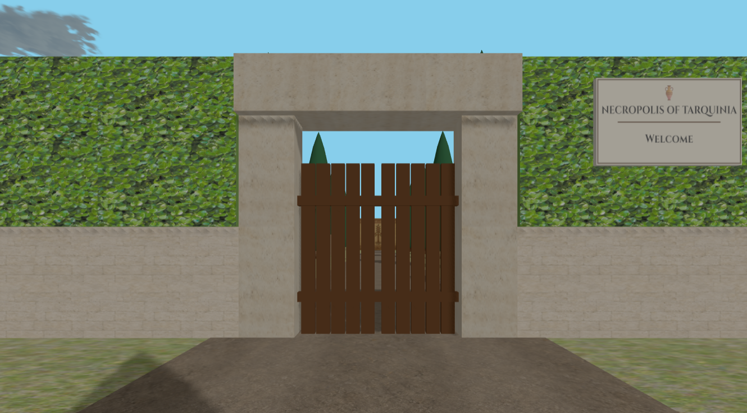
What is the project?
First-person exploration game
Inspired by the UNESCO Necropolis of Tarquinia
Educational archaeological experience
Collect three sacred relics
Unlock the Sacred Chamber

Slide 3
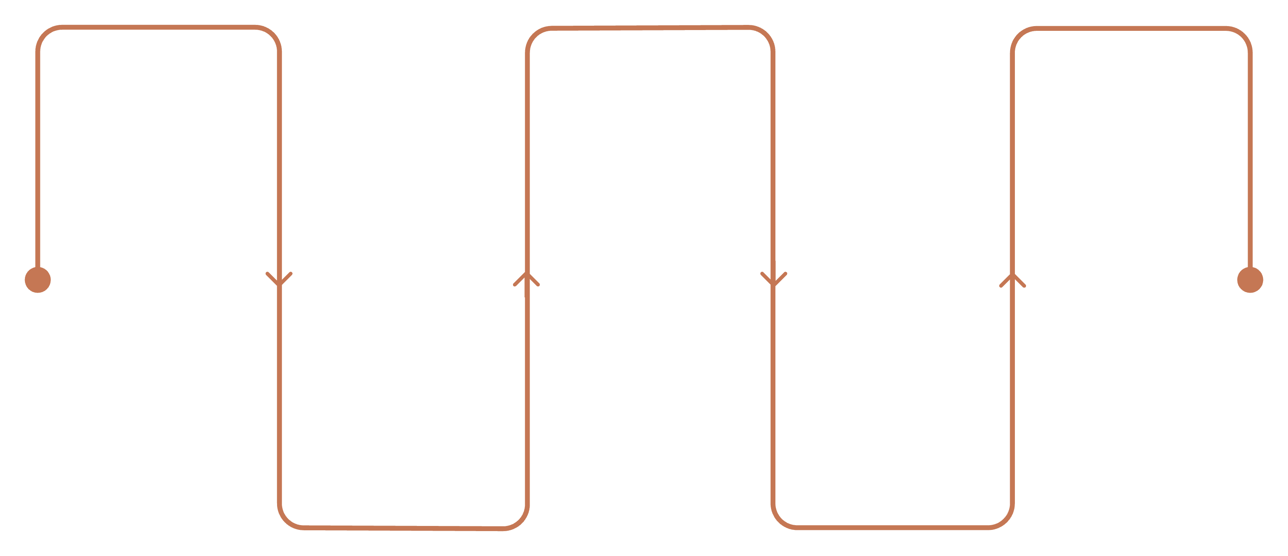
How does the game work?
Main Menu
Explore & Interact
Unlock the Sacred Chamber
Start the adventure
Explore tombs and discover hidden secrets
Place the relics to reveal the hidden passage
Equipment Selection
Collect Relics
Choose your archaeological tools
Find the three sacred artifacts
A linear narrative journey through the necropolis, culminating in the sacred chamber ritual.

Slide 4
Software Architecture
Core
Environment
main.js
Entry point
world.js
environment.js
UI
Logic
inventory.js
documents.js
collision.js
interaction.js
puzzle.js

Slide 5
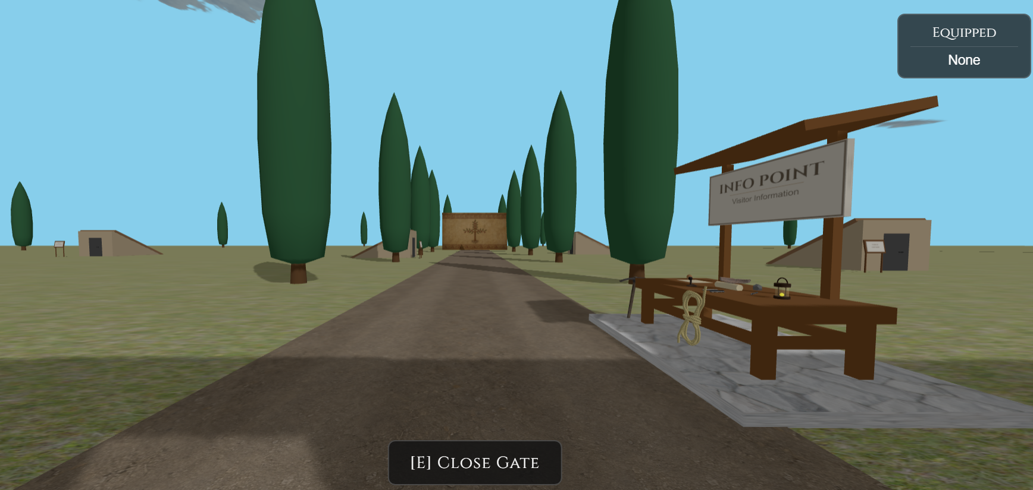
How was the environment built?
Static Elements
Terrain & Main Path
Six Explorable Tombs
Decorative Tombs
Sacred Chamber
Procedural Elements
Cypress Trees
Animated Clouds

Slide 6
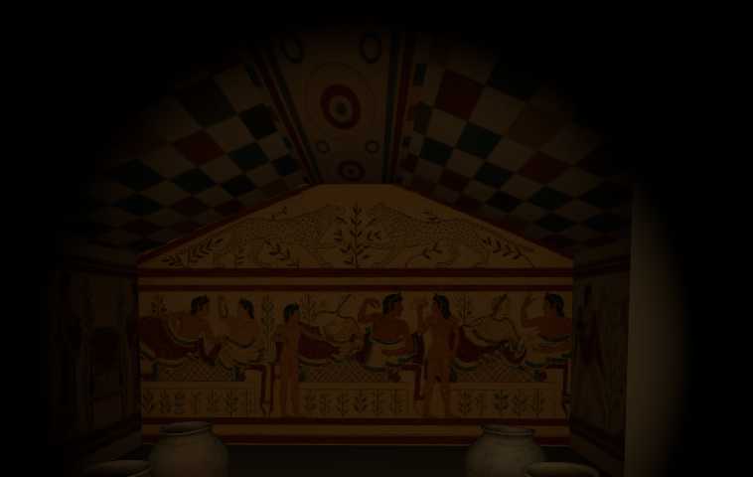
Graphics Techniques
Procedural Geometry
Texture Mapping
PlaneGeometry · BoxGeometry · CylinderGeometry · ExtrudeGeometry · LatheGeometry
Grass · Path · Frescoes · Normal Mapping · Repeating Textures
Imported Models
Lighting & Camera
GLTFLoader · Sacred Relics · Final Sarcophagus · Decorative Equipment Objects
Ambient · Directional · Shadow Mapping · PerspectiveCamera · PointerLockControls
Dynamic Scene Updates
Animated Clouds · Breakable Rocks · Wall Cleaning · Sliding Doors · Sacred Wall Collapse · Ambient Light Transition

Slide 7
How does the player interact with the world?
PLAYER CONTROLS
WASD
Mouse
E
Movement
Camera Control
Interact
F
ESC
Inventory
Pause Menu
INVENTORY SYSTEM
Equipment HUD - equipped tools always visible
Inventory Menu - inspect collected items and documents

Slide 8

Internal Game Loop
Player
Collision Detection
input
Game Loop
Player Input
Collision Detection
Interaction Check
Game State Update
Animations
Rendering
Game State Update
Rendering

Slide 9
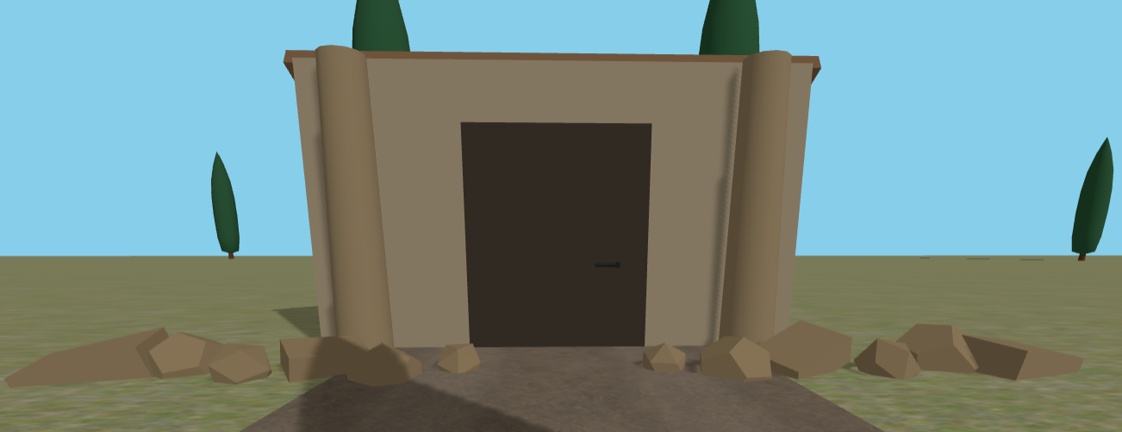
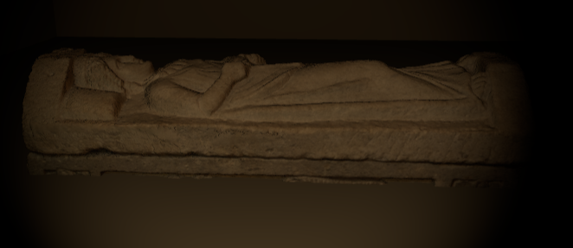
ENDING SEQUENCE
How is the ending implemented?
Collect Relics
Place Relics
Hidden Passage Opens
Interact with Sarcophagus
Ambient Light Animation
Camera Animation
Final Screen
Animations
Door Opening · Ambient Lighting · Camera Movement

Slide 10
Thank You
LIVE DEMO
THE ETRUSCAN TOMS
Martina Leggiero

